Slide 1
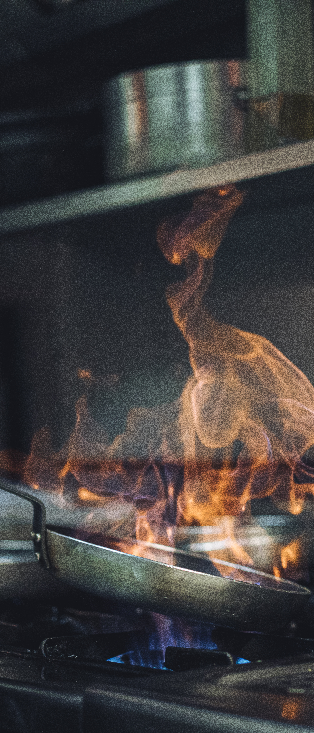

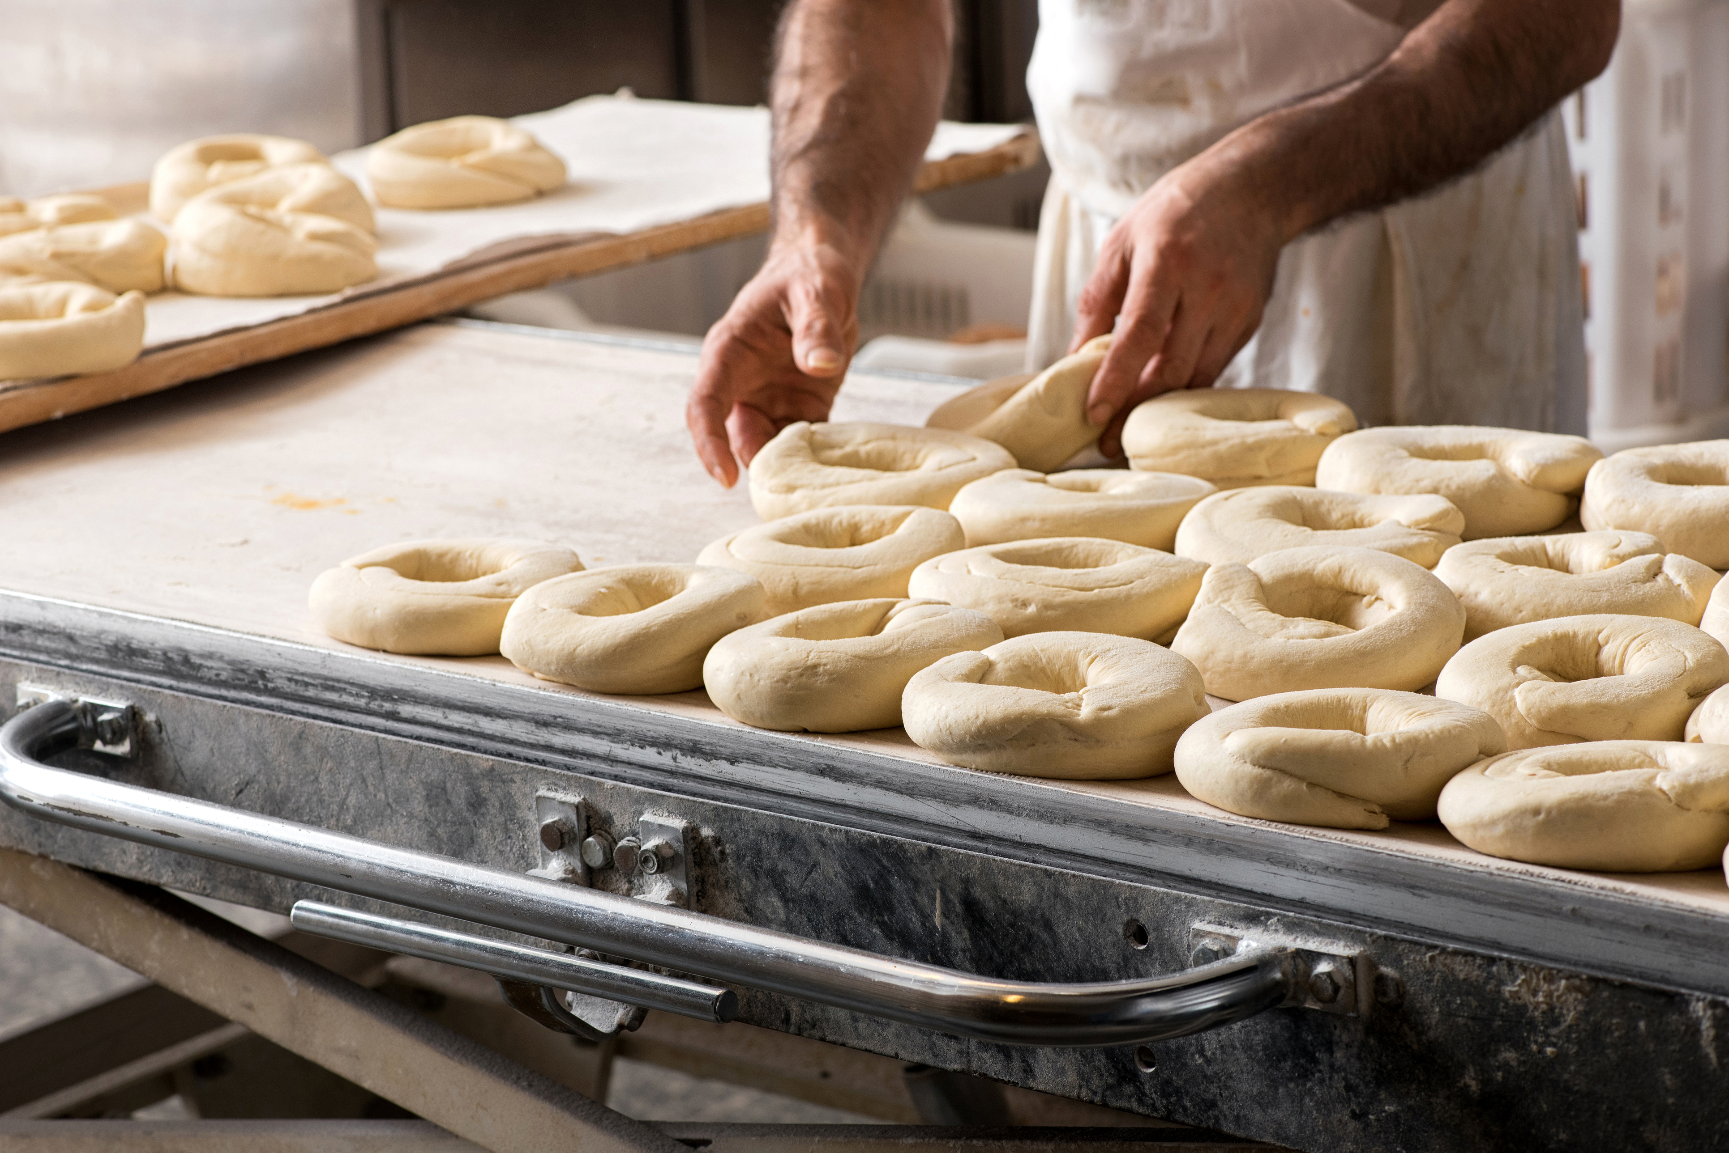
Pepper Preppers Kitchen is a commercial commissary kitchen available to food entrepreneurs for Hourly or Monthly rental.
Featuring brand new equipment and limited membership to reduce scheduling issues.
Available Equipment:
Double Oven
Stock-Pot Burner
2 Burner Range
60 Gallon Kettle
20 Quart Planetary Mixer
Ice Machine
Commercial Dishwasher
Large 3-part sink
Bottle Labeling Machine
Heat Tunnel for Shrink Wrap
Available for additional fees:
Reserve Full Kitchen
Contact Info:
Bill & Cheri Smoot, Owners
(509) 947-4454​
info@pepperprepperskitchen.com​
www.pepperprepperskitchen.com
Benton City, WA

Slide 2
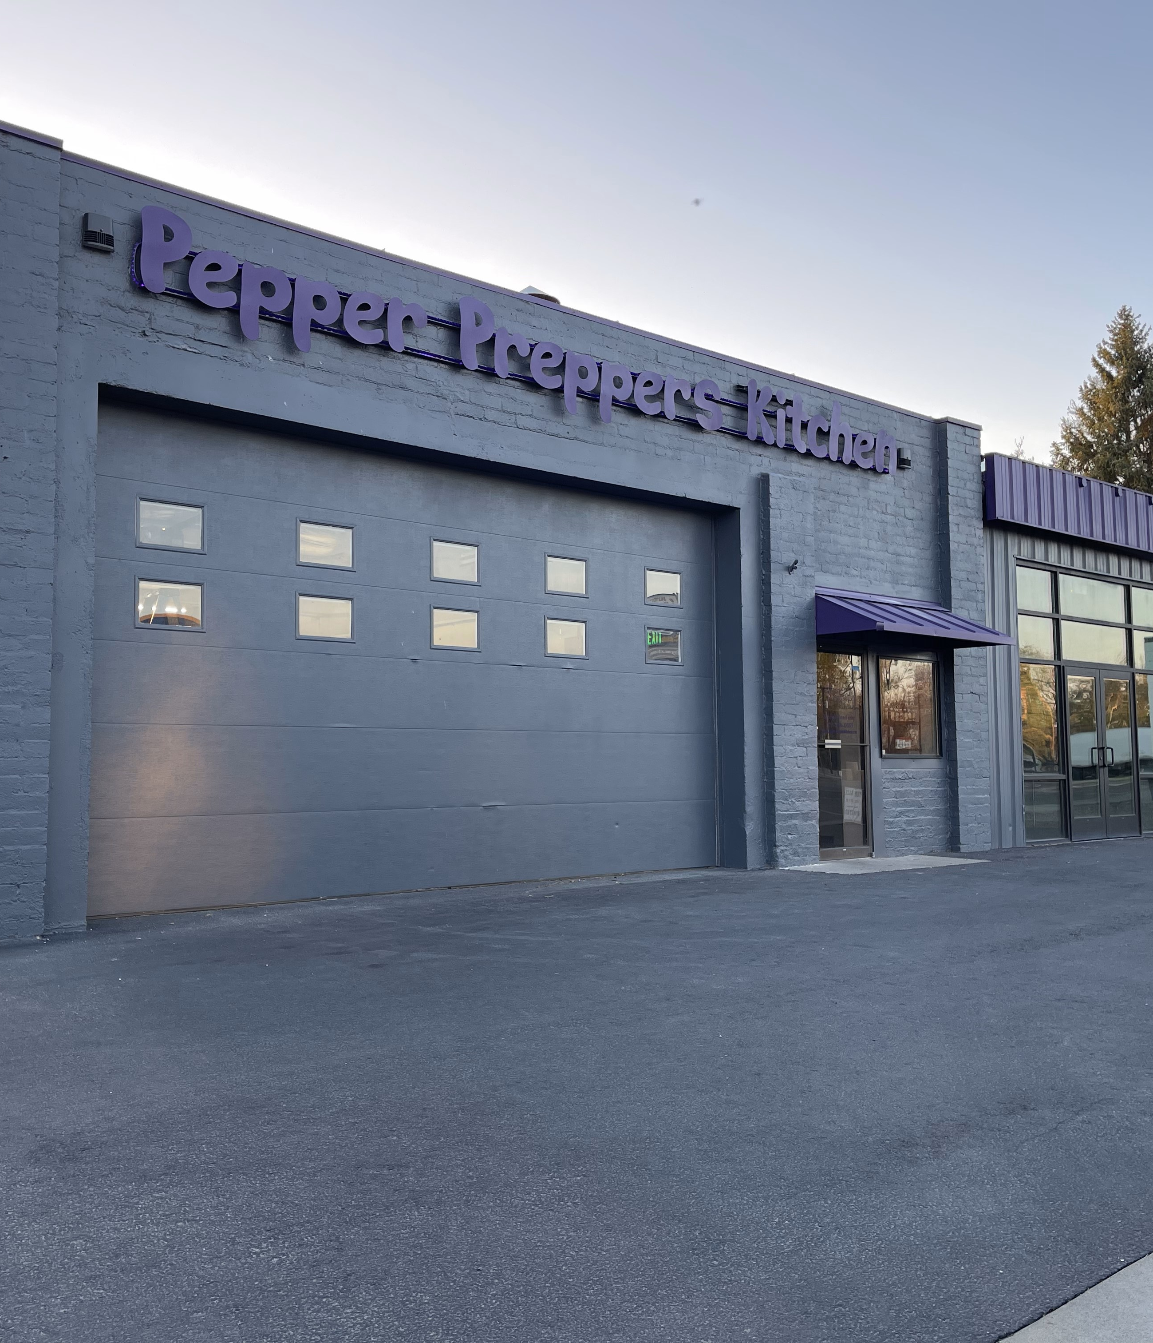
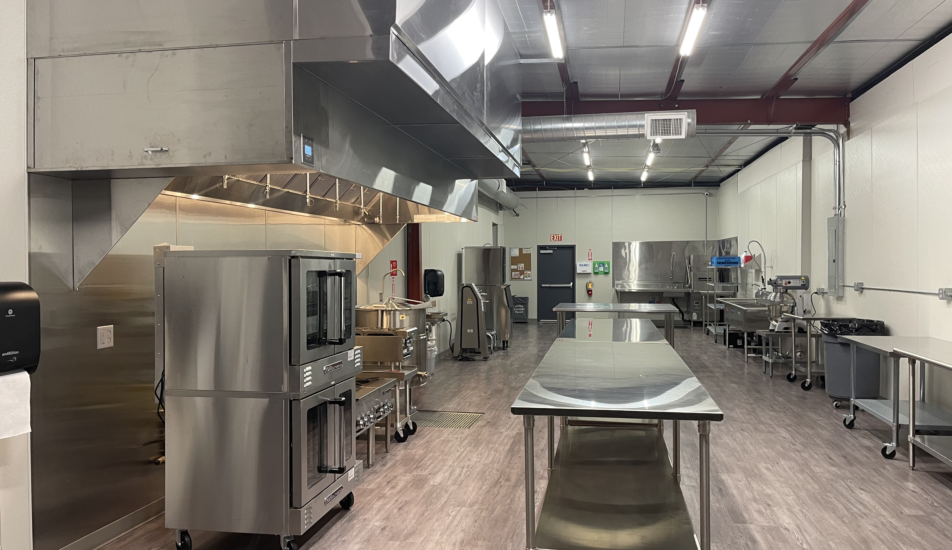
Kitchen Rates (Jan 2024): 2023)
Monthly Storage rates:
Refrigerator / Freezer
$60 (single 2’ x 3’ shelf)
$80 (single 2’ x 4’ shelf)
Rolling cage
$40 (single shelf 2’ x 4’)
$100 (entire cage – 3 shelves)
Monthly Storage rates:
Refrigerator / Freezer
$60 (single 2’ x 3’ shelf)
$80 (single 2’ x 4’ shelf)
Rolling cage
$40 (single shelf)
$100 (entire cage)
Caged area (6’ x 6’) - $125
Private rooms (when available) $150 - $250
*Custom rates negotiable
Caged area (6’ x 6’) - $125
Private rooms (when available) $150 - $250
*Custom rates negotiable
Monthly plans:
90 hours - $1080.00 ($12/hr)
60 hours - $780.00 ($13/hr)
40 hours - $ 560.00 ($14/hr)
20 hours - $ 300.00 ($15/hr)
10 hours - $160.00 ($16/hr)
*Overage hours charged at hourly rates
Hourly Rates: $18 per hour

